Slide 1
Fake News Detection
Notes:
Don’t move computer
Speak slowly
Be to the point

Slide 2
Presentation
Relevance of project
Data
Part 1: Classification
Part 2: Dynamic Word Embeddings
Conclusion
Questions and discussion
Notes:
Johan Horsmans
Feel free to interrupt me if you have any questions.

Slide 3
Relevance of project

Slide 4
Relevance of project
Background
Fake News misleads
Notes:
Fake News are misleading by definition
Influences public opinion and thus shape foreign and domestic policies around the world in a negative way

Slide 5
Relevance of project
Background
Fake News misleads
ML approaches show promising results
Notes:
Important to try and filter away Fake News, or detect them so we may – sort of – counteract them
Unfeasible to do manually
Previous ML approaches have seemingly succeeded in the task
Studies report high classif.
Ahmed et al., (mentioned in synopsis)
92% accuracy
Just using a relatively simple model with TF-IDF’s as features
BUT!

Slide 6
Relevance of project
Background
Fake News misleads
ML approaches show promising results
But! Generalizability?
Across sources
Across time
Notes:
BUT! Generalizability?
We theorized:
Across sources -> Model trained on articles from one set of news sources -> Not generalize to datasets with articles from other sources.
Also across time -> We suspect model trained on present and current articles -> not generalize to articles in the future, given that the topics they concern changes.

Slide 7

Relevance of project
Notes:
With off-set in the previously mentioned point, the scope of our project was to investigate:

Slide 8
Relevance of project
The potential lack of generalizability in the field

Slide 9
Relevance of project
The potential lack of generalizability in the field
The non-staticity of news articles

Slide 10
Data

Slide 11
Data
Two datasets:
Dataset 1 (large)
Dataset 2 (small)
Notes:
Dataset 1:
Roughly 45000 entries
Dataset 2:
Roughly 300 entries
Latter more carefully selected
Both used in previous research -> why we chose it
(2016-2017, and 2015-2017)

Slide 12
Data
Two datasets:
Dataset 1 (large)
Dataset 2 (small)
Preprocessing:
Cleaning from manual inspection
Lowercasing, stopwords + special characters, lemmatization
Notes:
Dataset 1
Systematic patterns, unrelated to the content of the articles
REUTERS

Slide 13
Part 1: Classification
Notes:
Assess generalizability across datasets

Slide 14
Part 1: Classification
BERT Base Uncased –
Notes:
Fine-tuned BERT Base Uncased (from HuggingFace), for the task of classifying Fake/Real News
One for 1st dataset
One for 2nd dataset

Slide 15
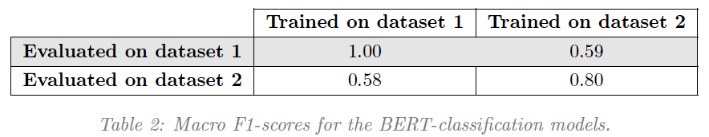
Part 1: Classification
BERT Base Uncased –
Notes:
Poor generalizability
= large drop in performance across datasets = model is overfitting to the specific dataset
Confounding factor -> Dataset 1:
F1-score = 1 -> Alarming – especially since we only ran 3 epochs
We optimized performance for the validation set. This is test-set performances.
Unrealistic performance related to data used:
These entries contain many abbreviations, misspellings, slang.
BUT it likely wouldn’t cause such high performance.
Poor quality data -> possible we missed something similar to the “REUTERS” in our cleaning, or other unrelated systematic patterns
Dataset 2:
More reasonable
Smaller dataset, higher quality. Quantity is not the only thing that matters.
Garbage in – garbage out
Despite confounds -> Models generalize poorly
Data from published research
-> Suggests problem for not only our models, but also for the field?
Generalizability problem may, however, be accommodated in future research by:
1) Assess generalizability of models more, e.g. -> Cross-testing own models on other datasets
-> This would enable us in knowing predictive capabilities in something closer to real-world settings.
Open science practices may allow this (sharing models, scripts and datasets)
2) If generalizability problems, then could be accommodated by focusing on data awareness
Large, publicly available datasets of high quality seems to be lacking within the field
Best if sampled from a wide array of sources.
-> Poor generalizability of models often stem from non-representative data

Slide 16
Part 2: Dynamic Word Embeddings
Notes:
Analysis 2:
More exploratory in nature
To assess temporal generalizability problems -> a more direct way would be to train BERT model on an earlier period, and test on a later
But we wanted something differently than just more BERT modeling

Slide 17
part 2: Dynamic Word Embeddings
Split dataset 1 into five periods
Equal number of days within each period
Notes:
Split data
Not just ordering by date, and splitting with equal number of entries in each period
Rather ordered by date, split by date

Slide 18
part 2: Dynamic Word Embeddings
Split dataset 1 into five periods
Equal number of days within each period
Trained fastText skipgram model on each period
Notes:
Trained fastText skipgram model on each period.
fastText is a word embedding module that utilizes skipgram with negative sampling.
So it’s actually a static word embedding model, but we’ve called it dynamic because the way our approach takes time into account
I’ll gladly explain how it works in detail - and also our choices for hyperparameters, if you want to hear more about that

Slide 19
part 2: Dynamic Word Embeddings
Split dataset 1 into five periods
Equal number of days within each period
Trained fastText skipgram model on each period
Word embedding for each word, for each period
Notes:
Resulting in a vector representation for each word for each time period.

Slide 20
part 2: Dynamic Word Embeddings
Split dataset 1 into five periods
Equal number of days within each period
Trained fastText skipgram model on each period
Word embedding for each word, for each period
Found nouns with largest semantic shift
Semantic distance defined as cosine distance in word embedding space
Notes:
Nouns with largest semantic shift between Period 1 and 5
We did that by computing the cosine distances of the words in word-embedding space, between period 1 and period 5.
As distances in word embedding space are a proxy for semantic similiarity

Slide 21
part 2: Dynamic Word Embeddings
Split dataset 1 into five periods
Equal number of days within each period
Trained fastText skipgram model on each period
Word embedding for each word, for each period
Found nouns with largest semantic shift
Semantic distance defined as cosine distance in word embedding space
Investigated changes in 10 nearest neighbours
Across time, using cosine distance
Notes:
We then looked at the changes in the 10 nearest neighbours for the nouns, across time.
To investigate whether the most semantically similar words changes over time.

Slide 22
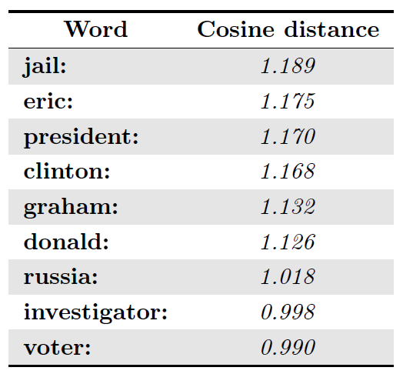
part 2: Dynamic Word Embeddings
Notes:
Found problems after submitting synopsis
regarding cosine distances
and comparing vector representations across different embedding spaces
feel free to ask

Slide 23
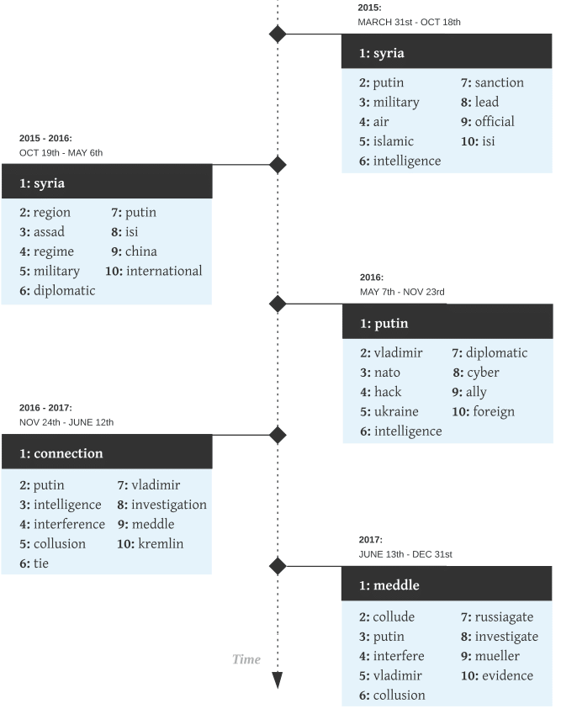
part 2:
Notes:
Explain graph ->
Syria in beginning,
Meddle + Collude in end (US election)
So we see large changes in semantics across time
Findings with grain of salt:
We handpicked words with most drastic changes in semantics
Illustrates how non-staticity interferes with building word-embedding representations that are reliable and generalizable across time periods.
This, in turn, also means that building a model for classification on some dataset from a given period, would not necessarily make the model generalizable to future datasets -> If we were to actually implement the models
If we want to practically implement these models, we, therefore, need to:
Continually update or retrain models with newest data
SKIP: Hypothetically, not a problem
Given large enough dataset spanning enough time
-> General patterns, that are unrelated to time-specific topics of news.
However, not feasible since such datasets don’t exist.

Slide 24
Conclusion
Notes:
Concluding remarks

Slide 25
Conclusion
Our findings suggest:
Low generalizability of models in the field
The task is non-static
Notes:
1st analysis: Models generalize poorly.
In future research we should therefore:
1. Be wary of data we’re using -> E.g. it would be advantageous to build large, representative datasets
2. We should also assess generalizability by cross-testing models, which would be facilitated by Open Science practices
The 2nd analysis illustrated that the task is non-static, although the extent of non-staticity was not established by this analysis. It was more an illustration than a test
Advantageous to continuously update models with new data, they are to be applied with success.

Slide 26
Notes:
Ændringer der mangler:
Cut en lille smule ned? Hvis jeg kan?
Concluding remarks for hver analyse.
Mangler linje I midten på plot
Læs op på BERT
Læs op på Macro F1-score
Anything I’d like to add?
fastText(!)
Preprocessing
Tokenization
By whitespace
How did our method used handle “it’s”
????
Stopword removal?
Removal of frequent, but information-low words.
Reduces noise and lowers computational power needed.
Lemmatization?
Lemmatization -> Grouping together inflected forms of the same word, into the lemma
What is a lemma?
Semantic nucleus of a word
Infinitive for verbs
Singular form for nouns
How is lemmatization carried out?
Two methods:
Look-up table
Morphology based approach (word internal structure to predict lemma, requires trained model)
Which lemmatization method did we use?
?????
What other preprocessing steps could have been utilized?
Instead of lemmatization, we could have used stemming:
Similar to lemmatization, but simpler (and not necessarily humanly interpretable):
Argue, argued, argues, arguing, and argus - > stem = argu
BERT
Macro F1-score
Classification matrix -> best
fastText skipgram
Word2vec upgrade, includes N-grams
100 dimensions
Problems of Dynamic Word Embeddings.
1) Cosine as distance
2) Comparing word embeddings across different models
3) If we had sampled data randomly from the same period, we would also have seen semantic shifts and changes in nearest neighbours
BERT base uncased
BERT large, higher scores, but at high computational cost
Datasets?
Size impact:
Small dataset -> Worse learning, poor evaluation metrics (few samples, more inaccurate)
Quaility impact:
Poor generalizability for poor quality

Slide 27
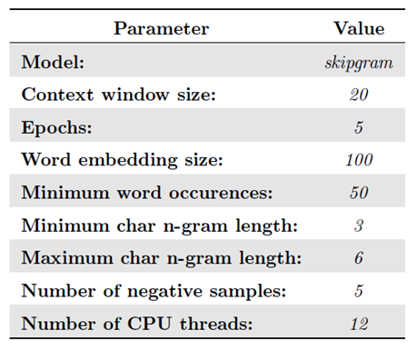
fastText
Notes:
FastText:
Word Embedding Module
Same as Word2Vec but 1 notable difference:
Using N-grams and summing the word embeddings for the N-grams instead of only using words.
-> Essentially language independent, as words are broken into N-grams
It implements skipgrams with negative sampling, which is quite ingenius:
Here, the embedding for a given word are the weights in a simple binary classification task
What skipgrams with negative sampling does is, that it uses a target word to predict context words
It, for a given target word:
Samples words that are within window size of target word
+ Samples words that are not.
Builds a logistic regression classifier for the given word to predict whether a context word is:
a positive class (occurs within window size)
a negative class (does not co-occur with target word)
Doesn’t use the classifier to predict, but just extract the weights -> the weights are then the embedding of a word
Why does it work?
“You shall know a word by the company it keeps”
1) Synonyms would appear in similar contexts
2) Since the classification task is based on context, then the classification task is similar
3) Similar tasks would entail similar weights -> therefore similar embeddings(!)
Then, because we’re using fastText rather than Word2Vec, we do this for n-grams instead. And then sum the n-gram embeddings for each word.

Slide 28
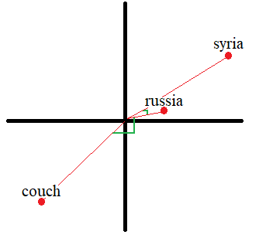
Expanding on word embeddings
Problem 1: Using cosine distances
Notes:
* Explain Distances from Russia to other words *

Slide 29
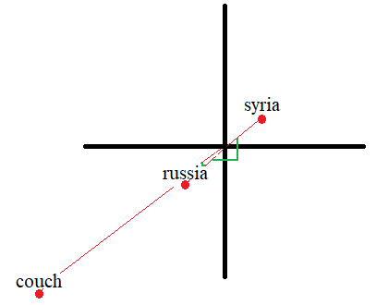
Expanding on word embeddings
Problem 1: Using cosine distances
Notes:
*Explain vastly different cosine distances*
-> Better to have used Euclidean distances

Slide 30
Expanding on word embeddings
Problem 2: Comparing word embeddings across different models

Slide 31
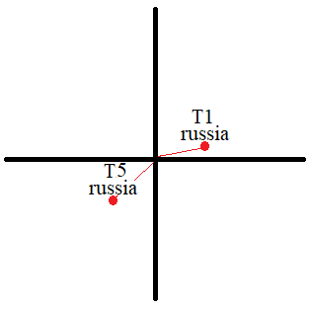
Expanding on word embeddings
Problem 2: Comparing word embeddings across different models
Time period 1 and 5:

Slide 32
Expanding on word embeddings
Problem 2: Comparing word embeddings across different models
Time period 1:
Time period 5:

Slide 33
Expanding on word embeddings
Problem 3: Changes happen, regardless of time
Notes:
Even if we had sampled Fake News and real news randomly from within the same period 5 times. And then had trained 5 models on these 5 datasets, then we would likely ALSO have seen semantic shifts as well as changes in nearest neighbours for the word Russia. Just because the data is different.

